Slide 1
Antipsychotics for better or worse: helping people make real choices about antipsychotic medication
Joanna Moncrieff
Kiran Azam
Cambridge
March 2014

Slide 2
Research team
Sonia Johnson- UCL
Neil Wood- HUB
Dinesh Kumar- NEFT
Heather Walker- NELFT
Nicola Morant- UEA
Katherine Darton- Mind
Louise Marston-UCL

Slide 3
The subjective effects of taking antipsychotic medication. Moncrieff, Cohen and Mason, Acta 2009
Quotes from askapatient.com
“extremely hard to move, think, talk” (haloperidol)
“heavy mental and physical stagnance” (haloperidol)
“emotionally empty, dead inside” (trifluoperazine)
“no emotions, only a weird, spacey, empty feeling, no arousal, no excitement, no joy, nothing” (risperidone)
“….my mind was in a constant fog of lethargy and indifference. I didn’t care about anything. I just wanted to sit around and eat.” (olanzapine)

Slide 4
Askapatient.com
“decreased the intensity of inner voices” (risperidone)
“stops my negative thoughts and feelings being amplified and overwhelming me” (risperidone)
“hypersomnia (increased sleeping), calming of moods, general smoothing out of mania, calmness, less hallucinations” (olanzapine).

Slide 5
Askapatient.com
“it makes me feel like a veggie, but that was better than what I was going through and it kept me out of the hospital” (olanzapine)
“Although I felt very well, I felt as if I had absolutely nothing to talk about. I kept wondering about whatever [it] was that had been so interesting during most of my life that I had suddenly lost… But I was very much in contact with reality and for that I was thankful” (haloperidol)

Slide 6
Other research on patient experience of antipsychotics
Patients find “side effects” worse than professionals judge them to be (Barbui et al, 2005; Seale et al, 2007)
Side effects reduce quality of life (Hofer et al, 2004)
Patients with schizophrenia want to be more involved in decisions about their drug treatment (Hamann et al, 2005)
Previous studies of “shared decision making” in psychiatric patients showed some improvement in satisfaction, participation , symptoms, and adherence (Malm et al, 2003; Hamann et al, 2006)

Slide 7
Background: policy
Self management of chronic conditions: Our Health, Our Care, Our Say, DoH, 2006
Recovery agenda
NICE Schizophrenia guideline (2014)- importance of patient involvement and collaborative decisions
Medicines Management: Everybody’s Business. NIMHE, 2008
NICE Adherence guideline (2009): more research on good communication about pros and cons of medical treatment

Slide 8
MRT Study: Introduction
Preliminary qualitative work
Development of the Medication Review Tool (form & website) and the on-going cluster randomised trial
Evaluate the effects of using the Tool.
Discuss some of the difficulties encountered in conducting this research.

Slide 9
Part 1: Understanding the subjective experience of taking antipsychotics, and development of a Medication Review Tool
Qualitative research
20 interviews with local service users
Semi-structured interview
Sample chosen to reflect a range of service users in terms of demographic characteristics like age, gender, ethnicity, duration of psychiatric illness, and experience of taking different types of antipsychotic.

Slide 10
Topics: Questions
Positive and negative effects of taking antipsychotic medication
Reasons for taking or not taking them
Opinions about current information about the drugs
Opinions about current opportunities for discussion about them with prescribers and others
Opinions about the merits or not of an Antipsychotic Medication Review Tool

Slide 11
Results: Main Themes
Positive & Negative side effects
Choice (or lack of)
Patient passivity (accepts taking med’s)
Fear of Relapse
+ve and –ve attitudes to med’s
Lack of Trust (service user – service and vice versa)
Discussions with professional - positive, not listened to, professionals prioritise illness over symptoms.
Other people want me to take med’s.
Don’t want to be on long-term.

Slide 12
Medication Review Tool
Designed to be completed by service user in collaboration with a mental health professional, as part of the on-going process of reviewing drug treatment.
Sections for considering main positive effects and negative effects.
Summary of “issues” to be discussed with prescriber.
Checklist of benefits and side effects

Slide 13
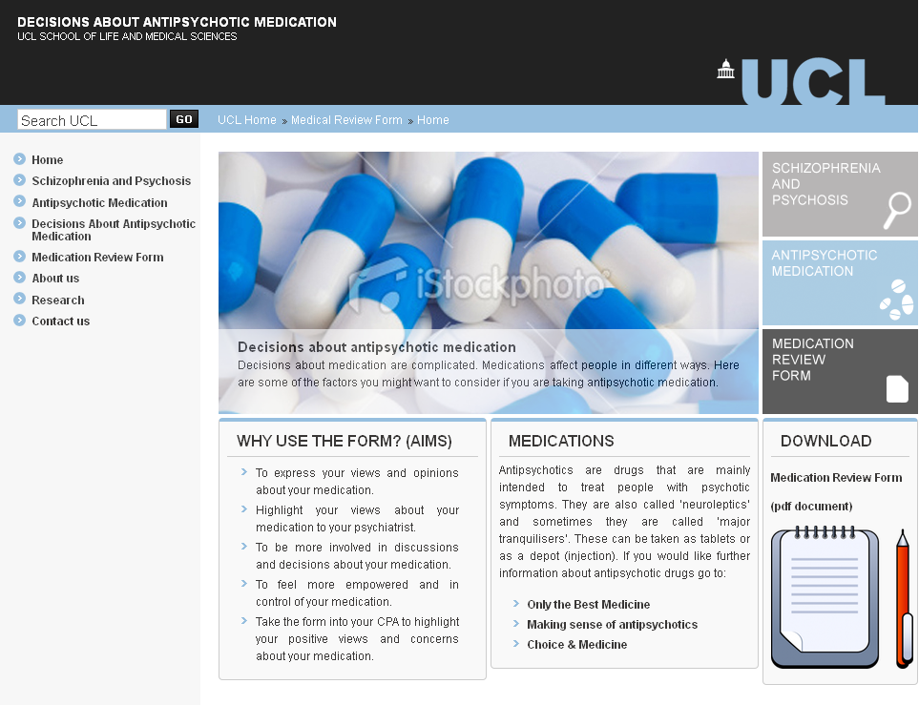
Medication Review Tool: Website

Slide 14
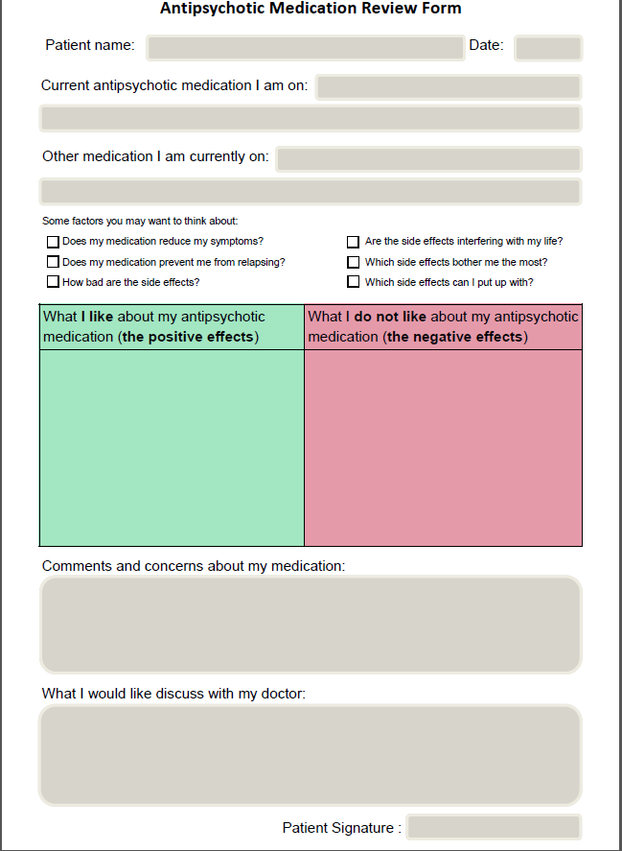
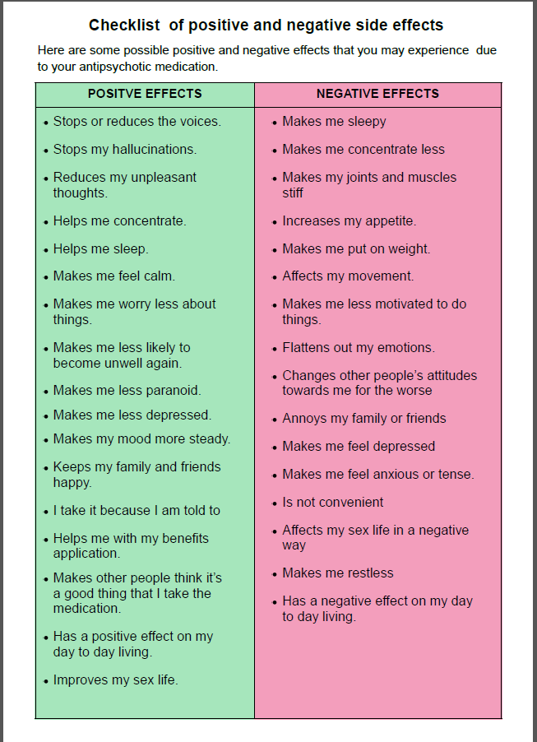
Medication Review Tool: Form

Slide 15
Part 2: Pilot cluster randomised controlled trial
60 participants
Adults (>18years)
Diagnosis of psychosis, schizophrenia & schizoaffective disorder.
Community Recovery Teams (CRT) & Early Intervention in Psychosis Service (EIPS), Assertive Outrearch Team (AOT).
Barking, Dagenham, Havering, Upminster, Waltham Forest & Redbridge.
Block randomisation of care coordinators
Numbers: 30 per group

Slide 16
Study Design
Identified Care co-ordinator
Client referrals
P₁
P₂
P₃
P_{x}
All participants assessed at baseline
Randomise Care co-ordinator
TAU
Intervention
Training
Use the form
Meeting with the psychiatrist
Follow up assessments

Slide 17
Intervention
Participants sent information from website (or link to it).
Training – go over the website and how to use the form. Training will be flexible (ie. one-to-one or group) and will take about 1 hour.
Will discuss and complete MRT with care coordinators just prior to CPA meeting with prescriber.
Will take MRT form into CPA or medical review meeting

Slide 18
Assessments
Main outcome: Decision Self Efficacy Scale (DSES; Bunn & O’Connor, 1996)
Baseline: DSES, Demographics, DAI, PANSS, LUNSERS, Compliance.
1st Follow up (2/4 weeks): DSES, Client Satisfaction Questionnaire, Qualitative data from service users, care coordinators and prescribers.
2nd Follow up (2/3 months): PANSS, LUNSERS, DAI, Compliance, Medication changes.
Qualitative feedback from clinicians (Physician Satisfaction Questionnaire)

Slide 19
Decision Self Efficacy Scale
My confidence in making an informed choice (11 items):
E.g. Get the facts about the medication choices available
Get the facts about the benefits of the choices
Understand the information given
Ask questions
Express concerns
Handle unwanted pressure
Get advice
Figure out the best decision for me

Slide 20
Outcomes: Process data
Recruitment of care coordinators, and clients
Retention and follow up
Ease and duration of completing Medication Review Tool

Slide 21
MRT: Methodological Challenges I
Recruitment
Referrals
Recruited more care co’s than expected (30 care co’s)
Care co’s not referring participants - self screening.
Opened up recruitment to more boroughs in London.
Some clients not having care coordinators
50% not eligible
Practicalities of cluster RCT.
Losing potential participants due to time constraints (time for refferals / CPA dates).
Delay in assessments
Care co’s taking long time to ask or clients taking a long time to reply regarding taking part.
Not being able to approach (%) of referrals due to CPA dates coming up.

Slide 22
MRT: Methodological Challenges II
Intervention & Implementation
Variation in enthusiasm and commitment of care coordinators
Clients being reallocated
Team restructuring
Team relocation
Care cos forgetting
Difficult to organise training, or training needing to be done in a very short period so done over the telephone.
main points could be communicated, but there was no opportunity to look over the website or form directly.

Slide 23
MRT: Methodological Challenges III
Pilot trial to evaluate a process for increasing the involvement of patients in making decisions about antipsychotic medication using a cluster randomised design.
The cluster design presented challenges, and the use of care coordinators to implement the intervention also complicated the implementation of the intervention.
The problems encountered reflect the pressures of modern day mental health services, and to this extent the research provides a good barometer of the practical feasibility of the process in ordinary practice.

Slide 24
Data Analysis
I Comparison of intervention and control group
II Within patient analysis of changes in ratings of positive and negative effects of antipsychotic treatment over time (intervention group only)
III Qualitative analysis of experience of completing and using the MRT in consultations from multiple perspectives

Slide 25
Thank you
Joanna Moncrieff
Principle investigator
(j.moncrieff@ucl.ac.uk)
Kiran Azam research assistant
(kiran.azam@nelft.nhs.uk)

