Slide 1
Can we do better than sharing? Findings from a 6-country study of clinical decision-making
Mike Slade
Professor of Health Services Research, Institute of Psychiatry
Consultant Clinical Psychologist, South London & Maudsley Trust
On behalf of Eleanor Clarke, Bernd Puschner, CEDAR Study Group
19 March 2014

Slide 2
Goals
How to research clinical decision-making?
Shared decision making
CEDAR Study
Implications

Slide 3
Dimensions of CDM
Pre-existing
Preferred involvement
Decision-specific
Topic
Experienced involvement
Satisfaction
Implementation
Dyadic perspective

Slide 4
Involvement in CDM
PASSIVE / PATERNALISTIC
to
SHARED
to
ACTIVE / INFORMED
Charles C et al (1999) Decision-making in the physician-patient encounter: revisiting the shared treatment decision-making model,
Social Science & Medicine , 49, 651-661.

Slide 5
Shared decision-making
Collaborative decision-making involving the sharing of information and expertise by both participants

Slide 6
Shared decision-making in MH
Under-researched in mental health: 2/11 RCTs
Joosten E et al (2008) Systematic review of the effects of shared decision-making on patient satisfaction, treatment adherence and health status, Psychotherapy and Psychosomatics, 77, 219-226.
“Further research is urgently needed”
Duncan E et al (2010) Shared decision making interventions for people with mental health conditions, Cochrane Database of Systematic Reviews:CD007297.
Widely recommended: “A shared decision making approach should be facilitated...”
National Institute for Health and Clinical Excellence (2011) Service user experience in adult mental health. CG136. London: National Collaborating Centre for Mental Health .

Slide 7
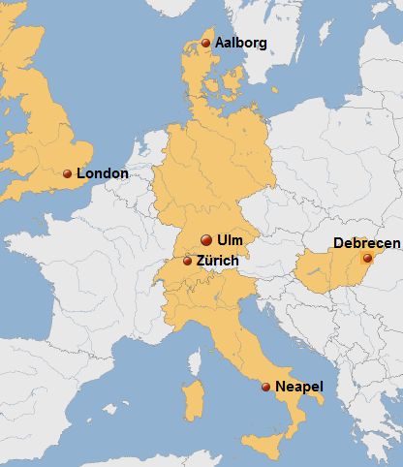
Clinical Decision Making and Outcome in Routine Care for People with Severe Mental Illness (CEDAR)
Naturalistic prospective longitudinal observational study
Bi-monthly assessments for 1 year
2009-2011
Out-patient / CMHT
Notes:
7

Slide 8
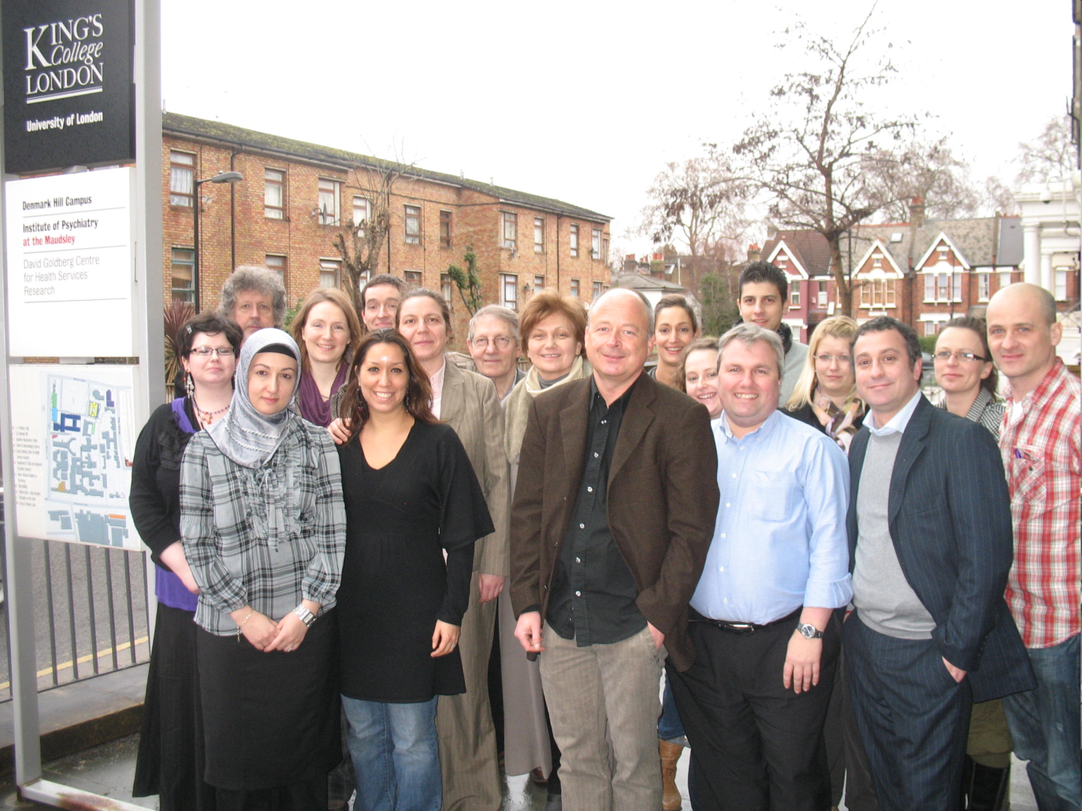
Acknowledgements
Esra-Sultan Ay, Sabine Loos, Katrin Arnold, Jana Konrad, Petra Neumann, Nadja Zentner | Ulm University, Germany Department of Psychiatry II
Harriet Jordan, Elly Clarke, Stephen Williams, Helena Kaliniecka | King's College London, UK Section for Recovery, Institute of Psychiatry
Andrea Fiorillo, Corrado De Rosa, Domenico Giacco, Mario Luciano | University of Naples SUN, Italy Department of Psychiatry
Roland Berecz, Tibor Ivanka, Marietta Nagy, Theodora Glaub, Zoltán Nemes | University of Debrecen, Hungary Department of Psychiatry
Malene Frøkjær Krogsgaard, Helle Østermark Sørensen, Jens-Ivar Larsen | Aalborg Psychiatric Hospital, Denmark Unit for Psychiatric Research
Wolfram Kawohl, Arlette Bär | University of Zurich Department of General and Social Psychiatry
Advisory Board: Margareta Östmann (Malmö/Sweden), Sue Estroff (Chapel Hill/USA), Dirk Richter (Bern/Schweiz), Istvan Bitter (Budapest/Ungarn).
The CEDAR study is funded by a grant from the Seventh Framework Programme (Research Area HEALTH-2007-3.1-4 Improving clinical decision making) of the European Union (Grant no. 223290).

Slide 9
Standardised measures (5 languages)
RATED BY
Service User Staff
HAS Yes Yes
CANSAS Yes Yes
OQ-45.2 Yes
MANSA Yes
STORI Yes
HoNOS Yes
GAF Yes
TAG Yes
Notes:
9

Slide 10
CDM measures (5 languages)
Service user and staff versions of
CDMS Clinical Decision Making Style
CDIS Clinical Decision making Involvement and Satisfaction
CDRC Clinical Decision making in Routine
Care
Notes:
10

Slide 11
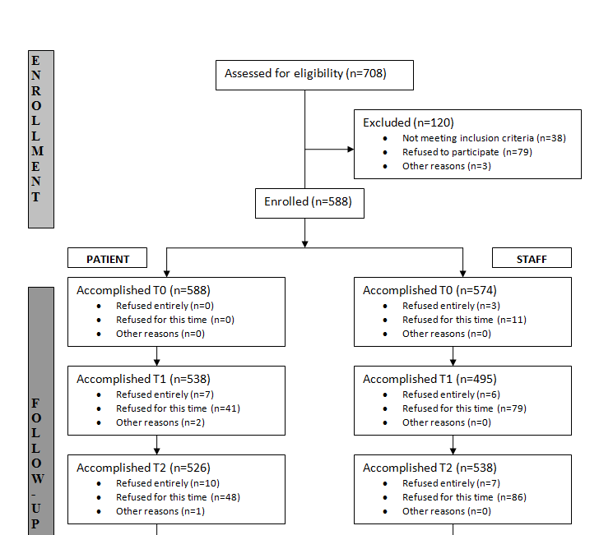
CEDAR Recruitment

Slide 12
Preference hypotheses
People using mental health services will be more satisfied with a specific decision if it is made using their preferred decision-making style (Active, Shared or Passive)
Notes:
12

Slide 13
Preference hypothesis (n=442)
Disempowered
Disempowered Disempowered
A Empowered Empowered
S Empowered
P
Matched
Matched
Matched
DESIRED
Active Shared Passive
A
S
P
EXPERIENCED
Notes:
13

Slide 14
Preference hypothesis (n=442)
6
26
11
A 15 3
S 19
P
5
2 13
% DESIRED
Active Shared Passive
A
S
P
EXPERIENCED
Disempowered
20%
Matched
43%
Empowered
37%
Notes:
14

Slide 15
Preference hypothesis (n=442)
SATISFACTION
Low Medium High
Empowered 4 36 60
Matched 5 44 52
Disempowered 13 47 40
EMPOWERMENT
Notes:
15

Slide 16
Ordinal logistic regression
 | Odds Ratio | Standard Error | P (two-tailed) | 95% Confidence Interval
 |  |  |  | Lower | Upper
Preference ( Reference category: Matched)
Disempowered (v Matched) | 0.55 | 0.61 | 0.041 | 0.30 | 0.98
Empowered (v Matched) | 1.38 | 0.34 | 0.193 | 0.85 | 2.24
Patient age | 1.03 | 0.01 | 0.006 | 1.01 | 1.05
London | 1.71 | 0.82 | 0.290 | 0.63 | 4.65
Naples | 0.73 | 0.34 | 0.494 | 0.29 | 1.82
Debrecen | 1.38 | 0.72 | 0.531 | 0.50 | 3.81
Aalborg | 3.55 | 1.53 | 0.003 | 1.52 | 8.25
Zurich | 0.43 | 0.19 | 0.052 | 0.19 | 1.01
Unmet Needs (CANSAS) | 0.86 | 0.03 | 0.000 | 0.79 | 0.93
Intraclass correlation coefficient | = 0.06
Agreement (Reference category: Disempowered)
Empowered (v Disempowered) | 2.53 | 0.80 | 0.003 | 1.37 | 4.70
Notes:
16

Slide 17
Agreement hypotheses
People using mental health services will be more satisfied with decisions they make with a clinician with the same preferred decision-making style.
Notes:
17

Slide 18
Agreement hypothesis (n=430)
Disempowered
Disempowered Disempowered
A Empowered Empowered
S Empowered
P
Matched
Matched
Matched
SU DESIRED
Active Shared Passive
A
S
P
STAFF DESIRED
Notes:
18

Slide 19
Agreement hypothesis (n=430)
2
41
18
A 5 1
S 16
P
10
1 7
% SU DESIRED
Active Shared Passive
A
S
P
STAFF DSIRED
Disempowered
18%
Matched
61%
Empowered
22%
Notes:
19

Slide 20
Agreement hypothesis (n=430)
SATISFACTION
Low Medium High
Empowered 1 33 66
Matched 5 45 50
Disempowered 15 40 45
EMPOWERMENT
Notes:
20

Slide 21
Ordinal logistic regression
 | Odds Ratio | Standard Error | P (two-tailed) | 95% Confidence Interval
 |  |  |  | Lower | Upper
Agreement (Reference category: Agree)
Clinician Disempowers (v Agree) | 0.78 | 0.24 | 0.422 | 0.43 | 1.43
Clinician Empowers (v Agree) | 2.35 | 0.70 | 0.004 | 1.31 | 4.23
Patient age | 1.03 | 0.01 | 0.009 | 1.01 | 1.05
London | 2.32 | 1.23 | 0.111 | 0.82 | 6.55
Naples | 1.03 | 0.48 | 0.957 | 0.41 | 2.56
Debrecen | 1.56 | 0.81 | 0.394 | 0.56 | 4.34
Aalborg | 4.02 | 1.78 | 0.002 | 1.68 | 9.57
Zurich | 0.05 | 0.22 | 0.108 | 0.20 | 1.17
Unmet Needs (CANSAS) | 0.86 | 0.03 | 0.000 | 0.80 | 0.93
class correlation coefficient = 0.05
Agreement (Reference category: Clinician Disempowers as)
Clinician Empowers (v Clinician Disempowers) | 3.02 | 1.16 | 0.004 | 1.42 | 6.39
Notes:
21

Slide 22
Summary
Experiencing more involvement in CDM than desired is associated with higher satisfaction
Decisions made with empowering staff are rated with higher satisfaction
Overall, more active involvement in decision-making than the service user stated as desired was associated with higher satisfaction.
Notes:
22

Slide 23
Recovery processes: The CHIME framework
Connectedness
Hope and optimism
Identity
Personal
Recovery
Meaning and purpose
Empowerment
Leamy M, Bird V, Le Boutillier C, Williams J, Slade M (2011)
A conceptual framework for personal recovery in mental health: systematic review and narrative synthesis,
British Journal of Psychiatry, 199, 445-452.
Notes:
97 papers included (5,208 papers identified 366 reviewed): 13 Characteristics of the Recovery Journey; 4 Recovery Processes (shown); Recovery Stage descriptions

Slide 24
Implications
Active decision-making, in which the service user makes the decision informed by the clinician, might be a more empirically defensible default style for clinicians to adopt than shared decision-making.
Notes:
24

Slide 25
Thank you
More information at researchintorecovery.com
and
cedar-net.eu/
Email: mike.slade@kcl.ac.uk

