Slide 1
Shared Decision Making in Psychiatric Medication Management: The Challenges
Prof. Shula Ramon
March 2014
shula.ramon@anglia.ac.uk
www.shimme.arcusglobal.com

Slide 2
Welcome
To this unique conference
To what is promising to be a fascinating range of interactive presentations and workshops
SHIMME is a co-production between the CPFT and Anglia Ruskin University, the first of its kind, hopefully leading to more such co-productions
It is also a co-production between different stakeholders: service users, practitioners from varied mental health disciplines, and researchers

Slide 3
What is SDM?
SDM is a process of sharing information, experience, and preferences, in which the decision is not known in advance.
According to Charles et al Gafni (1999) it entails:
the inclusion of at least two people, patient and clinician
who share information
take steps to build a consensus about preferred treatment
reach agreement on the treatment to implement
Deegan, Drake and Rapp (2010) add that the two participants are experts, though in different aspects

Slide 4
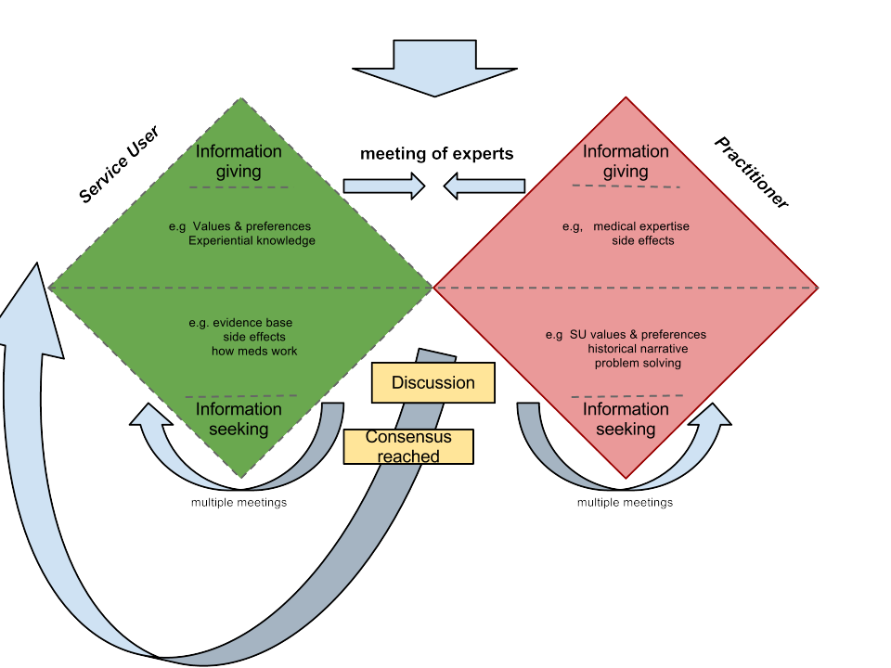

Slide 5
Why opt for SDM?
The belief in the value of shared decision in mental health is not new, and has been also expressed by NICE (2009) and the DH (2011).
SDM is valued as a tool that would enhance good working relationships, trust, and motivation to recover, as well as mutual learning from the different expertise that professionals and service users bring with them.
It sits well within the recovery oriented framework, in which enhancing control over one’s life and taking responsibility are key aims.
Yet while there are individual practitioner who practice it, it does not happen systematically in the NHS.

Slide 6
Why focus on SDM?
In addition:
Too many people do not take their medication regularly (50%), for a variety of reasons
There are growing doubts as to the efficacy of anti-psychotic medication (Morrison et al, 2012)

Slide 7
Previous attempts
Attempts to introduce systematic SDM in the context of medication exist in the form of two German RCT studies (Hamann, 2006, Loh 2007), some on going experimental projects in the US (Deegan, Drake and Rapp, 2010), some therapeutic communities (Soteria) and in the Open Dialogue approach (Seikkula, 2011).

Slide 8
Outcomes
No harm occurred as a result of the introduction of SDM
The introduction of the SDM did not require extra time
Patients in acute wards were able to follow the procedure and participate in the SDM process
Soteria and the Open Dialogue are reporting minimal use of medication, or no use at all, as part of the recovery process.
Service users satisfaction is reported.

Slide 9
Underlying assumptions
These projects are not based on the assumption that medication should not be given, but on the assumption that prescribing medication needs to be based on shared decision in which the scientific knowledge of the prescriber is related to the experiential knowledge of the service user.
Our study is the first UK attempt to focus on the process of achieving SDM and the process required to achieve it in psychiatric medication management, which we will share with you today.

Slide 10
Underlying Principles of our project
Ensuring non-tokenistic involvement of service users:
As co-leads from the bid stage onward to membership in all of the project working groups
As trainers alongside professional providers
As presenters
As co-researchers
Focus on the process of SDM in the context of medication, not on individual advise giving
The project does not take a position as to whether individuals need or do not need to take medication

Slide 11
The challenges to be faced
Meeting of two different types of knowledge or gap in knowledge?
Accessing and understanding information about psychiatric medication
Sharing power between unequal partners to SDM
Introducing innovation in a climate of complex and difficult change process for the practitioners
The impact of introducing innovation within a climate of cuts in welfare benefits and budgets of mental health services

Slide 12
Several other, equally important, related projects and initiatives will be presented today and I am sure we will become much better informed about the options, the barriers, and the facilitators of SDM in relation to medication and to mental health in general.
The day is designed to enable interaction, especially in the workshop part: ENJOY
I also hope we will come up with implementation ideas in the CPFT and in the NHS, as well as for further research.
My thanks list: too long to list here, but very important!
House Keeping notes

Slide 13
Thanks are due in particular to:
The RfPB and the NIHR
The CPFT and ARU
Our clinical studies officers (Alison Stribling and Sallyann Hurford, led by Lorna Jacobs)
The participants
Members of the working groups of the ShiMME project
Alex and Ben

Slide 14
References
Charles, C.,Gafni, A., Wealan, T. 1999 Decision-making in the physician-consumer encounter : revisiting the shared treatment decision-making model. Social Science and Medicine, 49 :651-61
Calton T, Ferriter M, et al (2008) A systematic review of the Soteria paradigm for the treatment of people diagnosed with schizophrenia. Schizophrenia Bulletin., 34: 181–192
Cooper C, Bebbington P, et al (2007) Why people do not take their psychotropic drugs as prescribed: Results of the 2000 National Psychiatric Morbidity Survey. Acta Psych. Scand., 116: 47-53
Curtis, L.C., Milstrey Wills S, D.J., Penney, S.S. Ghose, S.S., Mistler, L.A., Noahone, I.H., M. Delphin-Rittmon, Del Vecchio,P., Lesko,S. (2010) Pushing the Envelope: Shared Decision Making in Mental Health. Psychiatric Rehabilitation Journal 34, 1, 14-22
Day J, Bentall R, Roberts C et al (2005) Attitudes towards antipsychotic medication: The impact of clinical variables and relationships with health professionals. Arch. Gen. Psychiatry, 62: 717-724

Slide 15
References
Deegan, P.E. (2005)The Importance of personal medicine: A qualitative resilience in people with psychiatric disabilities, Scandinavian Journal of Public Health Services, 66, 29-35.
Deegan, P.E., & Drake, E.R. (2006). Shared decision making and medication management in the recovery process. Psychiatric Services, 5: 1636-1639
Deegan P, Rapp C, Holter M, Riefer M (2008) A program to support shared decision making in an outpatient psychiatric medication clinic. Psych. Services, 59: 603-605
Deegan, P. (2010) A web application to support recovery and shared decision making in psychiatric medication clinics. Psychiatric Rehabilitation Journal, 34, 23-28
Dept. of Health (2008) Medicines Management: Everybody’s Business. DH: London
Dept. of Health (2011) Liberating the NHS: Choice and Control. DH, Choice Team.
Drake, R., Deegan,P., Rapp, C., (2010) The Promise of Shared Decision Making in Mental Health. Guest Editorial. Psychiatric Rehabilitation Journal, 34,1,7-13.

Slide 16
References
Duncan, E., Best, C., Hagen, S. (2010) Shared decision making interventions for people with mental health conditions (Review) . Chichester: John Wiley and Sons, Ltd. The Cochrane Library, Issue 1.
Edwards A & Elwyn G (2009) Shared decision-making in healthcare: Achieving evidence-based patient choice. (2nd ed). OUP: Oxford
Hamann J, Cohen R, Leucht S, et al (2005) Do patients with schizophrenia wish to be involved in decisions about their medical treatment? Amer. J. Psychiatry, 162: 2382-4
Hamann, J., Cohen, R., Leucht, S., Buschm, R., Kissling, W.(2007) shared decision making and long termoutcome in schizophrenia treatment. Journal of Clinical Psychiatry, 2007, 68(7) : 992-7
Harding, C.M., Zahnister, J.M. (1994) Empirical corrections of seven myths about Schizophrenia with implications for Treatment. Acta Scandinavia Psychiatrica, 90, supplement 3-4, 140-146.
Harrow M & Jobe T (2007) Factors involved in outcome and recovery in Schizophrenia patients not on antipsychotic medications: A 15-year multifollow-up study. J. Nerv. & Ment. Disease 195: 406-414
Joosten E, DeFuentes-Merillas L, et al (2008) Systematic review of the effects of shared decision-making on patient satisfaction, treatment adherence and health status. Psychotherapy and Psychosomatics, 77: 219–226
Kaminskiy, e. Ramon, S., Morant, N. (2013) Exploring Shared Decision Making for Psychiatric Medication Management. In: Walker, S. (ed) Modern Mental Health: Critical Perspectives on Psychiatric Practice. London: critical Publishing, 33-48.

Slide 17
References
Loh, A., Simon, d., Wills CE Kristen,I., (2007a) The effects of a shared decision-making intervention in primary care of depression: a cluster-randomised controlled trial. Patient Education and Counselling 67, 324-32
Loh, A. Leonhard, R., Simon, D.., Wills, CE., ., Harter, M. (2007b) The impact of patient participation on adherence and conical outcome in primary care of depression. Patient Education and Counselling, 65, 69-78.
Malpass, A., Shaw, A., Sharp, D., Walter, F., Feder,G., Ridd, M., Kessler, D. (2009) “Medication career” or “Moral Career”? The two sides of managing antidepressants: A meta-ethnography of patients’ experience of antidepressants. Social Science and Medicine, 68, 154-168.
Morrison, A.P., Hutton, P., Shiers, D, Turkington, D. (2012) Antipsychotics: Is it time to introduce patient choice? British Journal of Psychiatry, 2011, 83-84.
NICE (2009) Medicine adherence: Involving patients in decision about prescribed medication and supporting adherence. London: NICE

Slide 18
References
Nose, M., Barbui, c. Tansella,M. (2003) How often do patients with psychosis fail to adhere to treatment programmes? A systematic review. Psychological Medicine 33, 1149-1160.
O’Connor, A.M., Bennett, C.L. Stacey, D.,Barry, M., Col, N.F., Eden, K.B. (2006) Decision aids for people facing health problems or screening decisions. Cochrane Database of Systematic reviews, issue 3.
Priebe, S. McCabe, R., Bullenkamp, J. (2007) Structured patient-clinician communication: 1 year outcome in community mental health care: Cluster Randomised Control Trial. British Journal of Psychiatry, 191:420-422.
Roe, D., Goldblatt, H., Balush-Klienman, V., Swarbrick. M., &
Davidson, L. (2009). Why and how people decide to stop taking prescribed psychiatric medication: Exploring the subjective process of choice. Psychiatric Rehabilitation Journal, 33(1), 38-46.

