Slide 1
Shared Decision Making: The Challenge of introducing it in Psychiatric Medication Management in the UK
Prof. Shula Ramon and Sheena Mooney
19 July 2013
shula.ramon@anglia.ac.uk
Sheena.mooney@cpft.nhs.uk
www.shimme.arcusglobal.com

Slide 2
What is SDM?
SDM is a process of sharing information, experience, and preferences, in which the decision is not known in advance.
According to Charles et al Gafni (1999) it entails:
the inclusion of at least two people, patient and clinician
who share information
take steps to build a consensus about preferred treatment
reach agreement on the treatment to implement
Deegan, Drake and Rapp (2010) add that the two participants are experts, though in different aspects

Slide 4
The focus on SDM in primary care has been in existence for sometime, especially around difficult decisions such as in the case of cancer intervention (O’Connor et al, 2006), i.e. where there is a conflictual decision to be made
Elwyn and his colleagues from Cardiff have developed an observation tool of SDM in primary care in the UK (Edwards and Elwyn, 2009).

Slide 5
The case for SDM in mental health
Shared decision making is proposed as a means to improve collaboration between clinicians and service users, enhancing the journey of recovery, self management (Schauer et al, 2007) and quality of life (Joosten, 2008)
Priebe, McCabe et al (2007) have demonstrated the effectiveness of following the patient’s agenda in clinical consultations in six European countries.

Slide 6
The case for SDM in mental health
The Department of Health and NICE are supportive of shared decision making as a way of working in mental health (Nice, 2009, DH 2008, DH 2011)
Ethically, SDM is the right thing to do
Thus far there are no evaluated SDM interventions in the UK
concerning to psychiatric medication

Slide 7
SDM in Psychiatric Medication Management is a problematic issue given that:
Research evidence highlights that 50% of mental health service users do not:
take the medication prescribed for them on a regular basis
often do not inform their prescriber of this decision (Nose, Barbui and Tansella, 2003)
Why do people stop taking medication, given the evidence as to its effectiveness? (Roe et al, 2009)
The growing doubts as to the efficacy of antipsychotic medication (Morrison et al, 2012)

Slide 8
Existing Evidence
SDM in an admission ward within an RCT design (Hamann et al, 2006). People with Schizophrenia, able to make decision, no harm, does not require more time than the usual consultation, had no impact on clinical outcomes ; one off intervention, 18 month follow up
Loh et al (2007a and 2007 b) SDM in primary care for people with depression; also RCT design, and also in Germany: able to make decisions, no harm, increased satisfaction among patients, no impact on clinical outcomes, does not require more time. One off intervention.

Slide 9
Existing Evidence
SDM systematic review of RCT studies (Joosten et al, 2008 vs. Duncan et al, 2010) RCT studies exist (US, Germany) SDM is effective for some people with Schizophrenia and with Depression, the need for more research with less loss in follow up.
Soteria (Calton et al, 2008) : residential therapeutic community with minimal, or no use of medication (US and Switzerland)

Slide 10
Existing Evidence
The Open Dialogue approach (Seikkula et al, 2011) : exercising SDM not only with the index patient but also with family and neighbours for over 10 years in Finland: high rate of recovery, minimal use of medication; those without medication do better, reduction in the prevalence of new cases of Schizophrenia
The lessons from the longitudinal studies on recovery from Schizophrenia pertaining to psychiatric symptoms and medication (Harding and Zahinster, 1994, Harrow and Jobe, 2007)

Slide 11
Existing Evidence
The lessons from the Hearing Voices Network (Australia, The Netherlands, the UK) (Romme et al, 2011)
Training 100 staff members in West London to apply the HVN approach (Dec 2012) (Prof. Steve Trenchard)

Slide 12
Experimental projects of SDM
(Deegan and Drake, 2006, Deegan et al, 2008, Deegan et al, 2010)
Systematic use of simple tools
Being supported by peers
Use of electronic means (www.patdeeegan.com/commonground)
Use of the concept of Personal Medicine (Deegan, 2005)

Slide 13
ShiMME is an independent research project funded by the NIHR under its Research for Patient Benefit (RFPB) programme (grant reference PB-PG 0909-20054)
Views expressed are those of the authors and do not necessarily represent those of the NHS, the National Institute of Health Research, or the Department of Health
It is a partnership between Cambridgeshire and Peterborough Foundation Trust and Anglia Ruskin University, including service users, providers, and researchers.
It is the only MH SDM piloted intervention in the UK.

Slide 14
The ShiMME project focuses on the process of shared decision making in psychiatric medication management in order to:
Create a more collaborative partnership between service users and prescribers in an area of central importance to mental health services
Enhance active participation of adult service users who have experienced psychosis
Use of tools developed as aid to SDM in practice

Slide 15
Phase 1 - A literature scoping review and a wide-ranging consultation exercise across the Trust about the content of the training programmes . Completed September 2011.
Phase 2 – Delivering the training programmes, based in Rehabilitation and Recovery Services, accompanied by a before and after rigorous evaluation of their impact. April 2012 to March 2013, follow-up begins in July 2013.

Slide 16
Evaluation
Key dimensions: processes and outcomes
Primary outcome: reduction in conflictual decision making
Tools: Conflictual decision making scale, Option, CSSRI, Recovery star, Attitudes to Drugs Taking.
Cost effectiveness analysis

Slide 17
The Challenges to be faced
Meeting of two different types of knowledge or gap in knowledge?
Accessing and understanding information about psychiatric medication
Sharing power between unequal partners to SDM

Slide 18
We conducted 7 consultation groups: 4 with service users (27 participants in total), and one each with psychiatrists, CPNs and care co-ordinators (26) between July and September 2011. All from the R&R services in Cambridge
Each group meeting lasted 90 minutes; interactive discussion methods were applied

Slide 19
Each discussion group focused on;
Current prescription and medication management practices
Levels of service user involvement
Satisfaction with existing practices and preferences for change
Examples of innovative initiatives to foster shared decision making
Identification of obstacles and opportunities to do with SDM
Participants’ ideas for content and format of the training programmes

Slide 20
All groups were in favour of SDM, but aware that it is not really implemented at present. Perceived barriers to achieving it included;
Assumed difficulties people would have making decisions during an acute episode of mental illness
Fear of risk if the wrong decision is taken
Lack of good enough information
Readiness to let prescribers decide on their own
Not having a trusting relationship

Slide 21
What can facilitate SDM?
Providing good enough information
Learning to weigh the information
Feeling listened to
The importance of good relationships
Taking seriously what the person has to say
Involving the care co-ordinator, family members, and friends in the process of SDM

Slide 22
The training programmes
All training programmes focus on the process of SDM, we do not provide advice on medication to any individual.
For R&R staff in Cambridge, Huntingdon and Peterborough.
Programmes were delivered in small, interactive, groups

Slide 23
The training programmes
Why parallel programmes?
Trainers: co-leads: a service user trainer and a professional providers (2 psychiatrists, one CPN senior nurse)
Duration: psychiatrists: two sessions of two hours each, Some self study, using the ShIMME website.
Care co-ordinators: three sessions of 90 minutes each
Service users: 4 meetings of 2.5 hours each+follow up meeting

Slide 24
Content : providers
What does SDM mean in the context of mental health services?
The process of SDM
Knowledge of research evidence, including of alternatives to medication
Critical issues in managing psychiatric medication in collaboration with service users
Systematic use of feedback forms (one from the patient, one from the psychiatrist) in consultation meeting with service users

Slide 25
Content: service users
The process of SDM
Knowledge of key research evidence, including of alternatives to medication
Critical issues in managing psychiatric medication in collaboration with service users
Systematic use of feedback forms (one from the patient, one from the psychiatrist) in consultation meeting with service users
Constructive assertiveness training

Slide 26
Content: service users
How to articulate one’s preferences re medication: benefits vs. adverse effects
Where to find reliable information and how to evaluate it
Learning to systematically share one’s experiences of taking medication and preferences with one’s prescribing psychiatrist
Sharing experiences and preferences with care co-ordinators, support staff, peer support workers

Slide 27
Content: service users
Developing a wellbeing plan, focused on personal medicine
Becoming aware of alternatives to medication

Slide 28
Sample
15 psychiatrists
35 care co-ordinators
47 service users
Difficulties in recruitment

Slide 29
Experience of being a service user trainer
Gained confidence
My contribution and experience was genuinely appreciated
Felt valued
Working with a professional colleague as an equal was a refreshing experience
Learnt more about the difficulties that professionals face

Slide 30
Participants’ experience
Pre-conceptions were challenged
Positive learning experience
Time was ring-fenced away from the pressures of work
Stimulated thought and discussion around everyday challenges
Opportunity to have frank discussions in a safe environment

Slide 31
Service users feedback
‘Very interesting with lively talk and shared involvement ‘
‘This was something I wish was in place 20 years ago, hopefully this will help people in the future’
‘I have discussed nearly everything that does concern me, it was enjoyable and interesting’
‘It will be easier to talk to my psychiatrist about changing my medication’
‘You listened to our opinions, especially with the service user feedback form’
‘Very well presented and very inclusive of each member of the group’
‘I hope I will feel more able to make the decision with the psychiatrist regarding my medication’
‘Personally, very useful and empowering’

Slide 32
Where are we now?
Implementation of ShIMME procedure in everyday R&R practice, leading to updating feedback forms
Support networks
Post programme evaluation
First publication

Slide 33
References
Charles, C.,Gafni, A., Wealan, T. 1999 Decision-making in the physician-consumer encounter : revisiting the shared treatment decision-making model. Social Science and Medicine, 49 :651-61
Calton T, Ferriter M, et al (2008) A systematic review of the Soteria paradigm for the treatment of people diagnosed with schizophrenia. Schizophrenia Bulletin., 34: 181–192
Cooper C, Bebbington P, et al (2007) Why people do not take their psychotropic drugs as prescribed: Results of the 2000 National Psychiatric Morbidity Survey. Acta Psych. Scand., 116: 47-53
Curtis, L.C., Milstrey Wills S, D.J., Penney, S.S. Ghose, S.S., Mistler, L.A., Noahone, I.H., M. Delphin-Rittmon, Del Vecchio,P., Lesko,S. (2010) Pushing the Envelope: Shared Decision Making in Mental Health. Psychiatric Rehabilitation Journal 34, 1, 14-22
Day J, Bentall R, Roberts C et al (2005) Attitudes towards antipsychotic medication: The impact of clinical variables and relationships with health professionals. Arch. Gen. Psychiatry, 62: 717-724

Slide 34
References
Deegan, P.E. (2005)The Importance of personal medicine: A qualitative resilience in people with psychiatric disabilities, Scandinavian Journal of Public Health Services, 66, 29-35.
Deegan, P.E., & Drake, E.R. (2006). Shared decision making and medication management in the recovery process. Psychiatric Services, 5: 1636-1639
Deegan P, Rapp C, Holter M, Riefer M (2008) A program to support shared decision making in an outpatient psychiatric medication clinic. Psych. Services, 59: 603-605
Deegan, P. (2010) A web application to support recovery and shared decision making in psychiatric medication clinics. Psychiatric Rehabilitation Journal, 34, 23-28
Dept. of Health (2008) Medicines Management: Everybody’s Business. DH: London
Dept. of Health (2011) Liberating the NHS: Choice and Control. DH, Choice Team.
Drake, R., Deegan,P., Rapp, C., (2010) The Promise of Shared Decision Making in Mental Health. Guest Editorial. Psychiatric Rehabilitation Journal, 34,1,7-13.

Slide 35
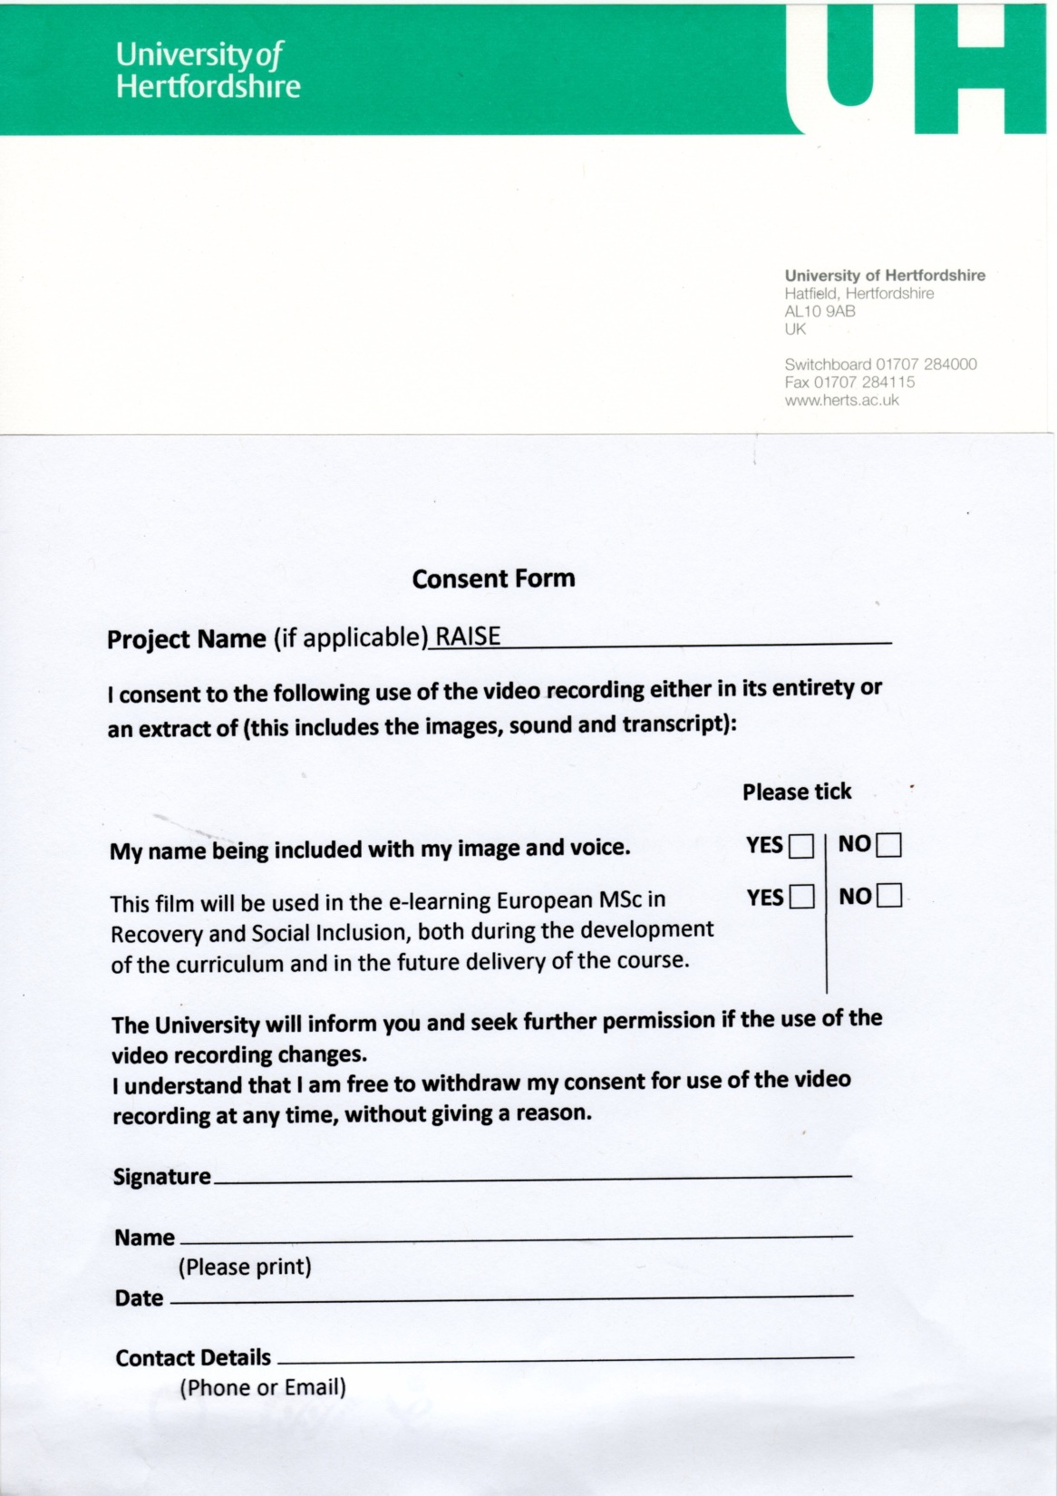
References
Duncan, E., Best, C., Hagen, S. (2010) Shared decision making interventions for people with mental health conditions (Review) . Chichester: John Wiley and Sons, Ltd. The Cochrane Library, Issue 1.
Edwards A & Elwyn G (2009) Shared decision-making in healthcare: Achieving evidence-based patient choice. (2nd ed). OUP: Oxford
Hamann J, Cohen R, Leucht S, et al (2005) Do patients with schizophrenia wish to be involved in decisions about their medical treatment? Amer. J. Psychiatry, 162: 2382-4
Hamann, J., Cohen, R., Leucht, S., Buschm, R., Kissling, W.(2007) shared decision making and long termoutcome in schizophrenia treatment. Journal of Clinical Psychiatry, 2007, 68(7) : 992-7
Harding, C.M., Zahnister, J.M. (1994) Empirical corrections of seven myths about Schizophrenia with implications for Treatment. Acta Scandinavica Psychiatrica, 90, supplment 3-4, 140-146.
Harrow M & Jobe T (2007) Factors involved in outcome and recovery in Schizophrenia patients not on antipsychotic medications: A 15-year multifollow-up study. J. Nerv. & Ment. Disease 195: 406-414
Joosten E, DeFuentes-Merillas L, et al (2008) Systematic review of the effects of shared decision-making on patient satisfaction, treatment adherence and health status. Psychotherapy and Psychosomatics, 77: 219–226
Kaminskiy, e. Ramon, S., Morant,N. (2013) Exploring Shared Decision Making for Psychiatric Medication Management. In: Walker, S. (ed) Modern Mental Health: Critical Perspectives on Psychiatric Practice. London: critical Publishing, 33-48.

Slide 36
References
Loh, A., Simon, d., Wills CE Kristen,I., (2007a) The effects of a shared decision-making intervention in primary care of depression: a cluster-randomised controlled trial. Patient Education and Counselling 67, 324-32
Loh, A. Leonhard, R., Simon, D.., Wills, CE., ., Harter, M. (2007b) The impact of patient participation on adherence and conical outcome in primary care of depression. Patient Education and Counselling, 65, 69-78.
Malpass, A., Shaw, A., Sharp, D., Walter, F., Feder,G., Ridd, M., Kessler, D. (2009) “Medication career” or “Moral Career”? The two sides of managing antidepressants: A meta-ethnography of patients’ experience of antidepressants. Social Science and Medicine, 68, 154-168.
Morrison, A.P., Hutton, P., Shiers, D, Turkington, D. (2012) Antipsychotics: Is it time to introduce patient choice? British Journal of Psychiatry, 2011, 83-84.
NICE (2009) Medicine adherence: Involving patients in decision about prescribed medication and supporting adherence. London: NICE

Slide 37
References
Nose, M., Barbui, c. Tansella,M. (2003) How often do patients with psychosis fail to adhere to treatment programmes? A systematic review. Psychological Medicine 33, 1149-1160.
O’Connor, A.M., Bennett, C.L. Stacey, D.,Barry, M., Col, N.F., Eden, K.B. (2006) Decision aids for people facing health problems or screening decisions. Cochrane Database of Systematic reviews, issue 3.
Priebe, S. McCabe, R., Bullenkamp, J. (2007) Structured patient-clinican communication: 1 year outcome in community mental health care: Cluster Randomised Control Trial. British Journal of Psychiatry, 191:420-422.
Roe, D., Goldblatt, H., Balush-Klienman, V., Swarbrick. M., &
Davidson, L. (2009). Why and how people decide to stop taking prescribed psychiatric medication: Exploring the subjective process of choice. Psychiatric Rehabilitation Journal, 33(1), 38-46.

