Slide 1
Introducing Shared Decision Making in Psychiatric Medicines Management as part of a Recovery Agenda
Dr Elina Baker, Clinical Psychologist
Devon Partnership NHS Trust
UK

Slide 2
Development
Phase One
Jason Fee, Louise Bovingdon, Tina Campbell, Elaine Hewis, Lesley Mahoney, Danny Lewis, Glenn Roberts

Slide 3
Recovery is a personal journey
“Recovery is a deeply personal, unique process of changing one’s attitudes, values, feelings and goals, skills and/or roles. It is a way of living a satisfying, hopeful and contributing life even with the limitations caused by illness. Recovery involves the development of new meaning and purpose in one’s life as one grows beyond the catastrophic effects of mental illness.” (Anthony, 1993)

Slide 4
Recovery as a foundation for mental health practice
Mental health services support people’s recovery journeys by:
  Focussing on personal (not professional )goals
  Instilling hope
  Working with strengths & building positive identity
  Helping people discover what works for them, make choices & take responsibility
  Coaching & educating not treating
  Re-connecting with communities & overcoming discrimination
  Valuing personal experience

Slide 5
Adopted in policy
Nationally
Locally

Slide 6
Taking a Recovery based approach to medication
Project group formed 2008
Clinical Psychologist, Consultant Psychiatrist, Pharmacist, Staff Nurse, Person with lived experience of taking medication, Person in caring role
Review existing literature
Principles in Devon Recovery Guide: what would we be doing if we were using them to guide practice?
Consultation with people who take medication, informal supporters and mental health workers
Development of guidelines

Slide 7
The lived experience of medication
Consistent with other research and published accounts:
  Useful for stabilisation
  Side effects interfere with personal recovery
  Alternative strategies desirable but rarely offered
  Experience of being patronised, not given information or choice, fear of compulsory treatment
  Welcomed being listened to & involved in decision making, given information & choice

Slide 8
The role of medication in personal recovery: from ‘taking’ to ‘using’
Recovery is individual: people’s experiences of medication will be individual
Not about the effectiveness of medication but the person’s relationship with it: taking up an active stance
A tool that people can choose to use to help them achieve their personal recovery goals

Slide 9

Recommendations: supporting people to take an active stance
Adopt a shared decision making approach
Valuing the person’s experience, goals and explanatory frameworks
Helping people access and evaluate information
Weighing risks and benefits
Exploring alternatives
Crisis planning
Joint learning process

Slide 10
Further information
Baker, E., Fee, J., Bovingdon, L., et al.(2013). From taking to using medication: recovery-focused prescribing and medicines management. Advances in Psychiatric Treatment, 19, 2-10
www.recoverydevon.co.uk
  Advisory paper & summary report
  Paper on survey findings

Slide 11
Implementation
Phase Two
Debbie Marriot, Liz Frayn, Elaine Hewis

Slide 12
Supporting prescribers
Pilot training workshops:
  2 x 2 hour workshops, 1 month apart + homework
  Pharmacist, Psychiatrist, Psychologist, Person with lived experience
  Policy and evidence rationale for shared decision making
  Problem solving around perceived barriers
  Tools and decision aids
  Reflective practice exercise: rating an interaction
  Exploring ‘self-management’ alternatives

Slide 13
Barriers & potential solutions
Perception that ‘we’re doing it already’
Story from lived experience facilitator & results of our survey
National vs local routine ‘service user experience’ survey, below average for:
  Side effects explained
  Purpose of medication explained

Slide 14
Barriers & potential solutions
Lack of ‘insight’ or shared understanding of the problem
  Listening and keeping an open mind about what might help
  Link to person’s own goals and prescribing for effects (e.g.: tranquilisers not anti-psychotics)
  Identify areas of agreement / overlap of goals
  Treat it as a trial, rate the effects and review use

Slide 15
  Barriers & potential solutions
Too much information?
  Negotiating levels of involvement
  Evidence that access to information doesn’t reduce adherence
  Range of sources of information at different levels of complexity: www.choiceandmedication.org

Slide 16
Barriers & potential solutions
Times of crisis and increased risk
  Crisis plans and advance directives
  Honesty about concerns
  Choice from a more limited range of options
  Crisis as a ‘learning opportunity’: debrief and review
  Involving families

Slide 17
Feedback
29 people attended
High rate of drop out between session 1 & 2
10 responded to survey requesting feedback
  7/10 thought the workshop had made a difference to how they involved people
  Discussion of barriers most useful element
  Self-management rated less useful
  7/10 thought single session format better

Slide 18
Next steps
Compulsory training for all prescribers
Single session format
Pre-session task, using reflective practice tool
Focus on barriers, problem solving and tools
15 sessions planned Sept 2013 – April 2014
Evaluation through ongoing ‘service user experience’ survey

Slide 19
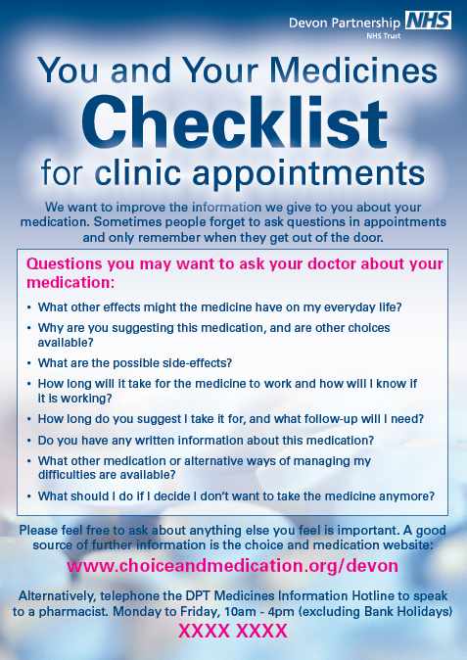
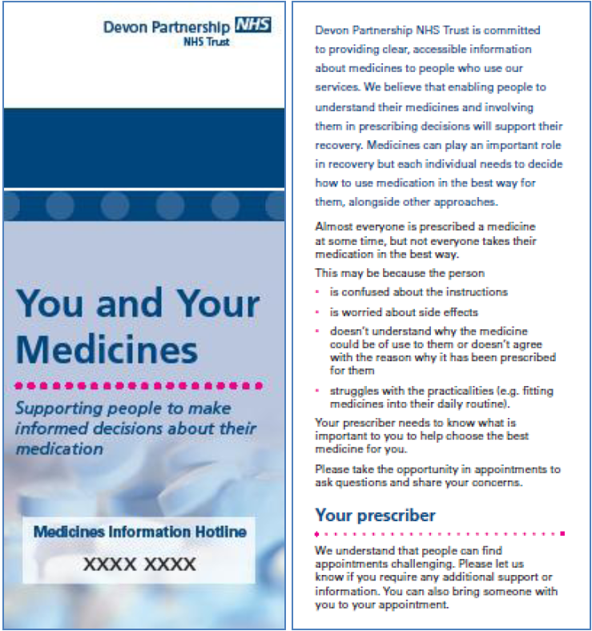
Supporting people taking medication

Slide 20
Workshops
  2 x 2 hour workshops, 1 month apart + practice
  Psychiatrist, Psychologist, Person with lived experience
  Sharing personal experience
  What is shared decision making?
  Sources of information about medication
  Tools
  Preparing for appointments
  Monitoring effects
  Alternatives to medication

Slide 21
Feedback and next steps
2 pilot workshops in in-patient settings, community workshop planned
Balancing issues of space to share experience with opportunity to learn
Inclusion in ‘recovery college’ program for Autumn term

Slide 22
Organisational culture
Facilitator
Obstacle
Recovery focus
Quality improvement targets
Compulsory training (risk management)
Limited financial investment
Need to demonstrate cost-effectiveness
  Reduced prescription rates
  Improved clinical outcomes

